Slide 1
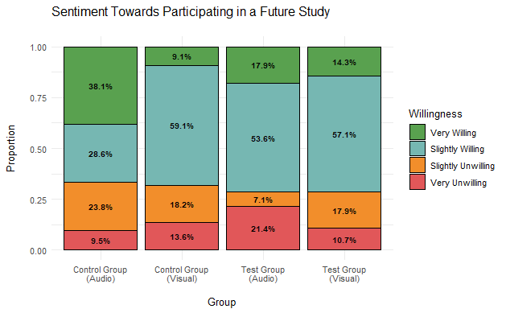
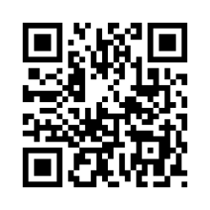
Combating Misinformation with a Humorous Audio Ad: A Qualitative Analysis of a Pilot Study
Kendall Beaver¹, Diana Daley^{2,3}, Kainan Garrett²
¹Graduate Researcher, ²College of Information, ³Advisor & Primary Investigator
Introduction
Results
Use incomplete sentences
Smallest size body text 36
Keep word count to minimum
They used the software “descript”
Image
Image
Image
Use incomplete sentences
Smallest size body text 36
Keep word count to minimum
Use incomplete sentences
Smallest size body text 36
Keep word count to minimum
Materials and Methods
Image
Image
Image
Use incomplete sentences
Since this is description, this is allowed to be slightly smaller
Keep word count to minimum
Discussion
Acknowledgements & References
Use incomplete sentences
Since this is description, this is allowed to be slightly smaller
Keep word count to minimum
Use incomplete sentences
Smallest size body text 36
Keep word count to minimum
More data needs to be gathered
B/c the participants had time to complete the 2nd test, it’s possible that external factors may have influenced their responses
Image
I would like to thank Diana and Kanian for their support, as well as the financial support of our anonymous donor for this unique and interesting project. Additionally, don’t forget about your logos. You need the KEYS, BIO5, and Ken R. Coit College of Pharmacy logo and those required by your lab.
Daly, Diana, and Kainan Jarrette. “Design of Audio Ads to Prebunk Misinformation and Promote Civil Discourse.” Information research 30.iConf (2025): 249–259. Web.
10.47989/ir30iConf47359
Use incomplete sentences
Since this is description, this is allowed to be slightly smaller
Keep word count to minimum
Use incomplete sentences
Since this is description, this is allowed to be slightly smaller
Keep word count to minimum
Image

